Slide 1



fullstackdatascience.com
Advanced Excel for Data Analysis
Essential Tools for Data Analysis
Created by Huydata
DA K6
Lesson 3
huynt@fullstackdatascience.com
1

Slide 2

Learn
About
01/
PowerPivot
02/
What-if Analysis
03/
Data Transformation
fullstackdatascience.com
2

Slide 3

PowerPivot
Power Pivot is a data modeling technology that lets you create data models, establish relationships, and create calculations. With Power Pivot you can work with large data sets, build extensive relationships, and create complex (or simple) calculations, all in a high-performance environment, and all within the familiar Excel experience.
3

Slide 4
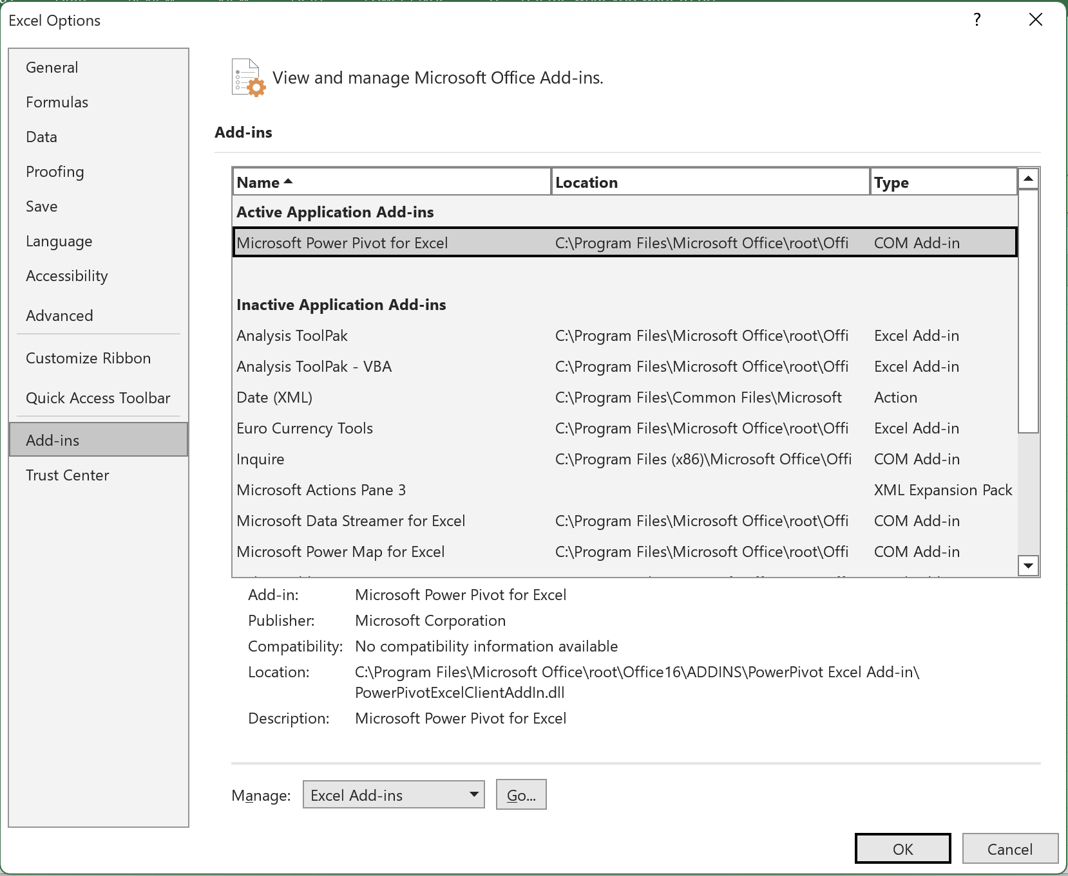


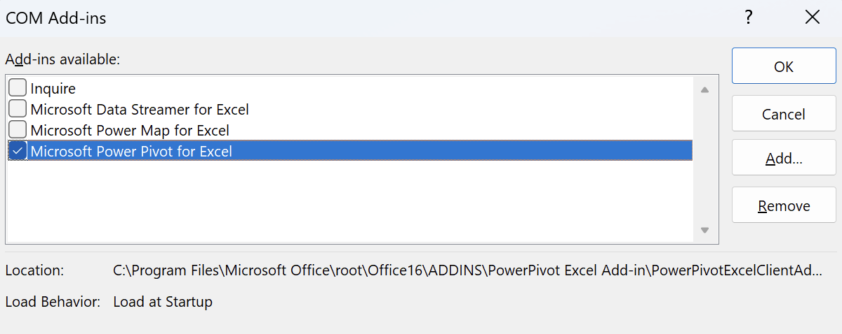
Turn on Power Pivot
5

Slide 5
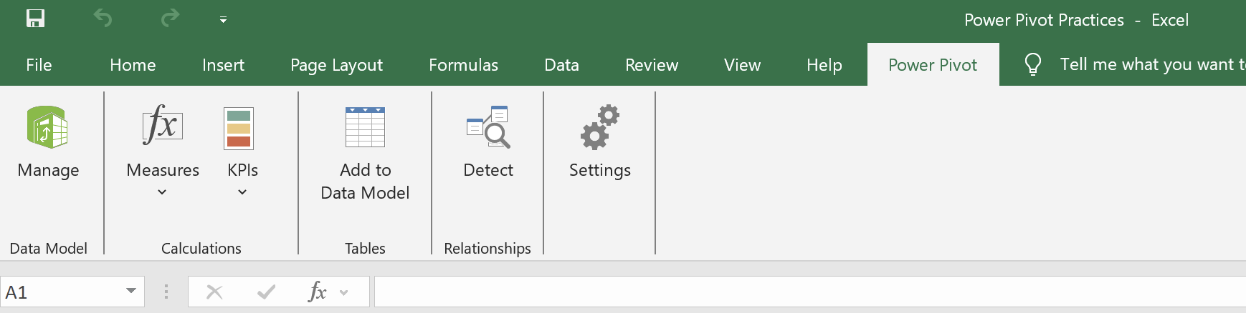
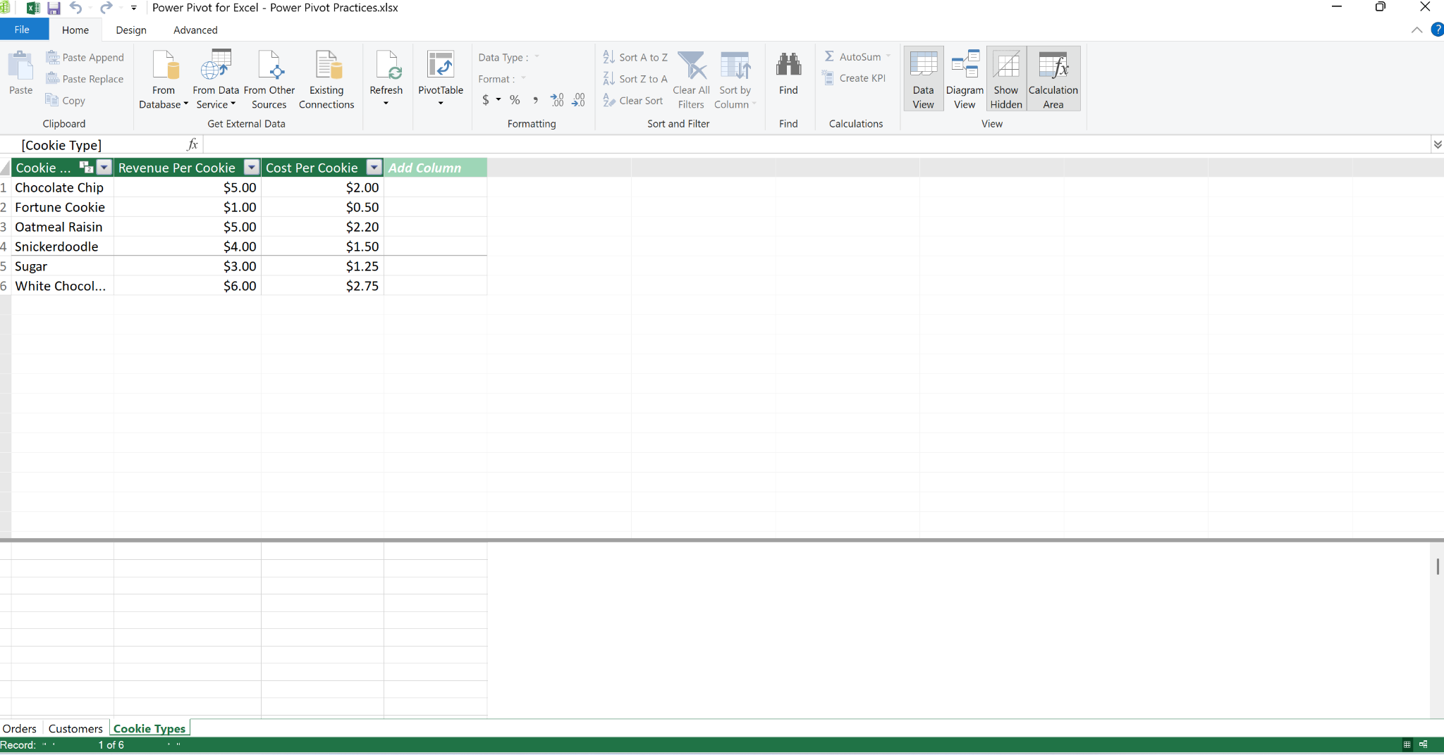
Power Pivot Interface - Get data
5

Slide 6
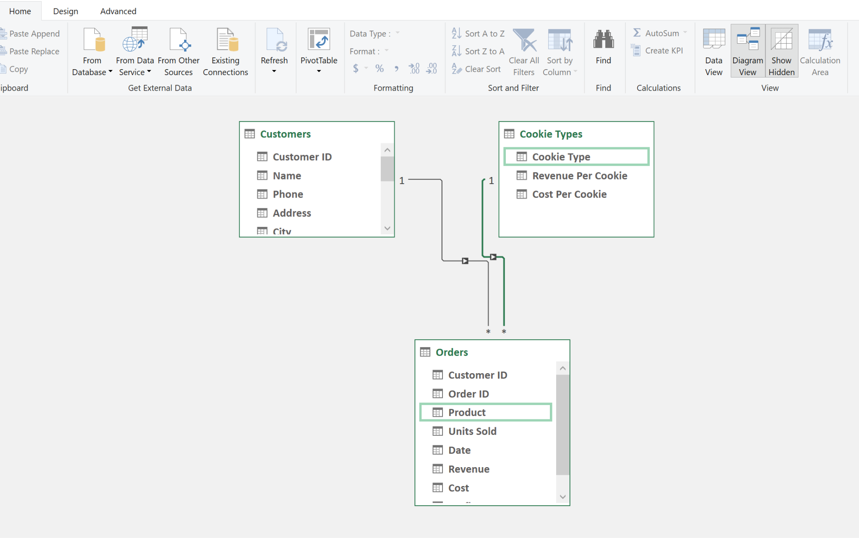
Power Pivot - Relationship
5

Slide 7
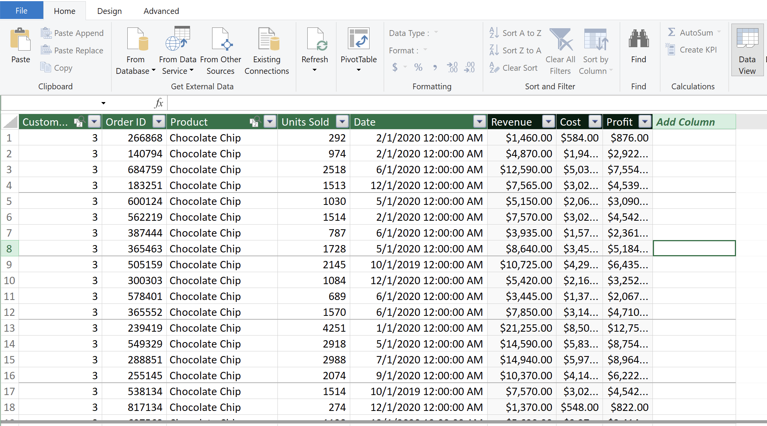
Power Pivot - Calculated Column
A calculated column is a new column added to a table in your data model using a DAX formula. It calculates a value for each row in the table.
5

Slide 8
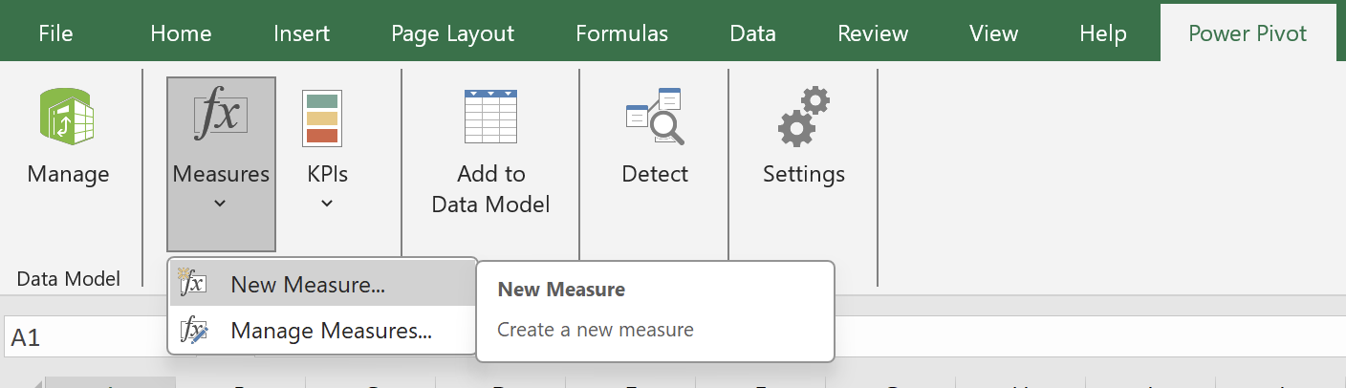
Power Pivot - Measure
A measure is a formula that performs calculations on data aggregated across the whole table or dataset. It returns a single value depending on the context of the filter, slicer, or pivot.
5

Slide 9
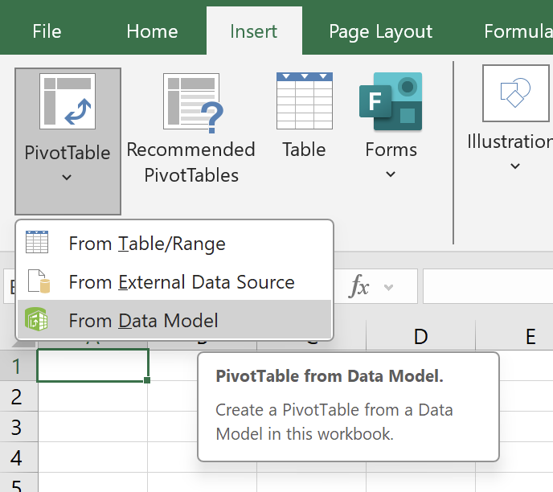
Power Pivot with PivotTable
5

Slide 10
PRACTICES
Count total number of orders sold
Draw a chart showing the total number of orders sold by each Customer
4

Slide 11

WHAT-IF ANALYSIS
3

Slide 12
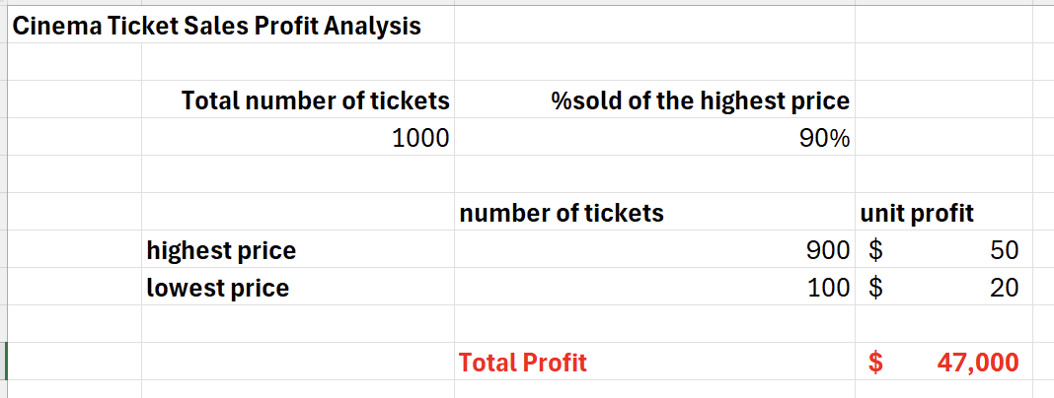
Cinema Ticket Sales Profit Analysis
What if 60%?
What if 70%?
What if 80%?
5

Slide 13
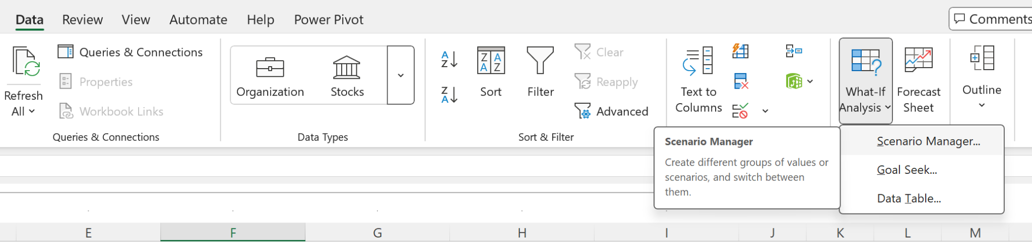
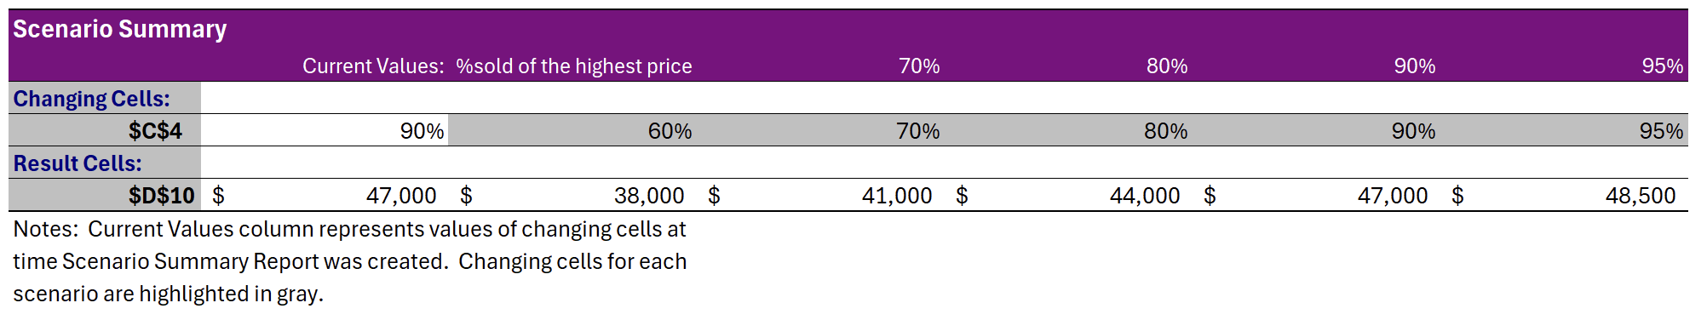
Cinema Ticket Sales Profit Analysis
Scenario Summary
5

Slide 14
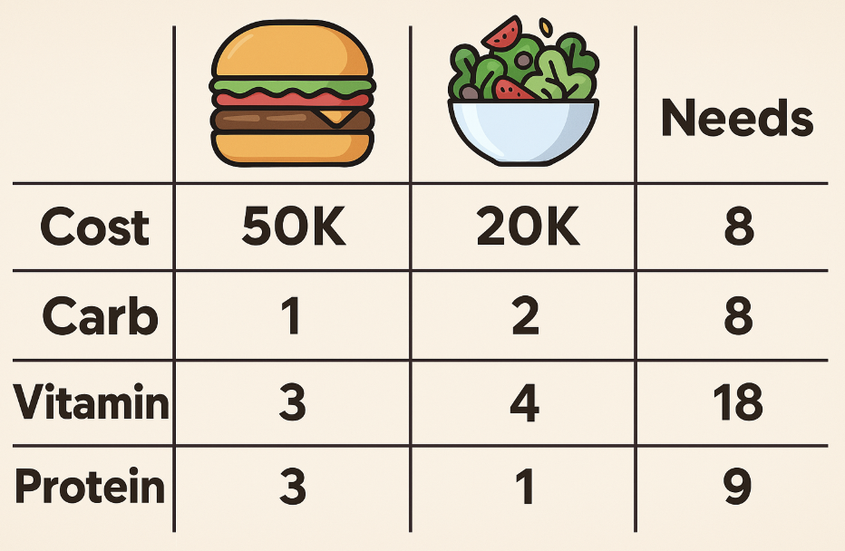
Solver for Optimization
Cost minimization problem
5

Slide 15
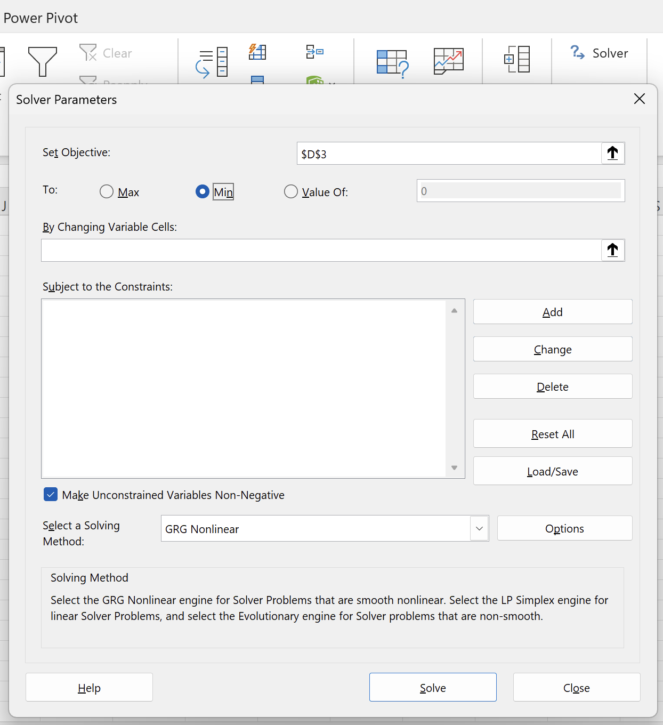
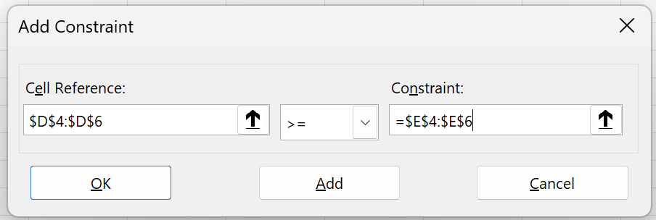
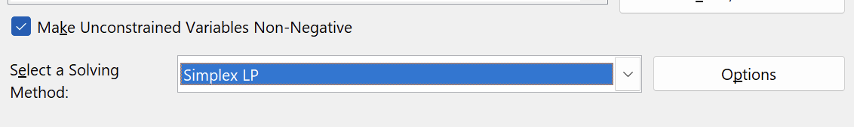
Solver for Optimization
Linear Programming
5

Slide 16
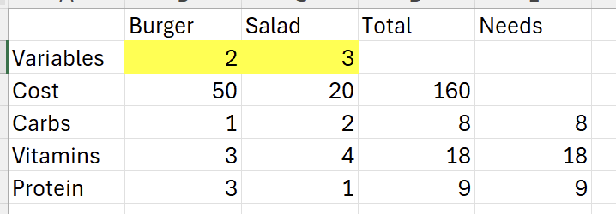
Solver for Optimization
5

Slide 17
Solver for Optimization
Case Study - Optimize Production to Maximize Profit
Imagine you run a factory that produces two products: A and B.
Each unit of Product A gives a profit of $20
Each unit of Product B gives a profit of $30
Product A requires:
2 hours of labor
3 units of raw material
Product B requires:
4 hours of labor
2 units of raw material
You have:
100 hours of labor available
120 units of raw material available
Question: How many units of A and B should you produce to maximize profit, without exceeding the available resources?
5

Slide 18

Data Transformation
3

Slide 19
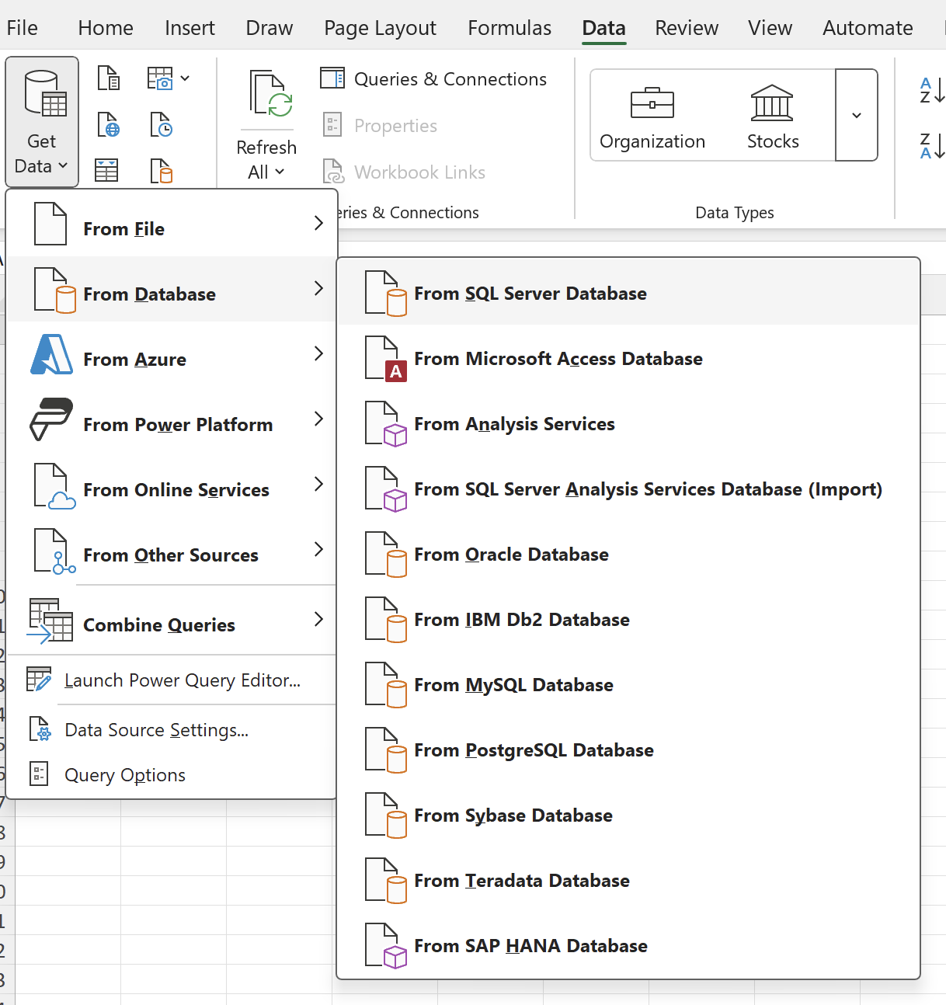
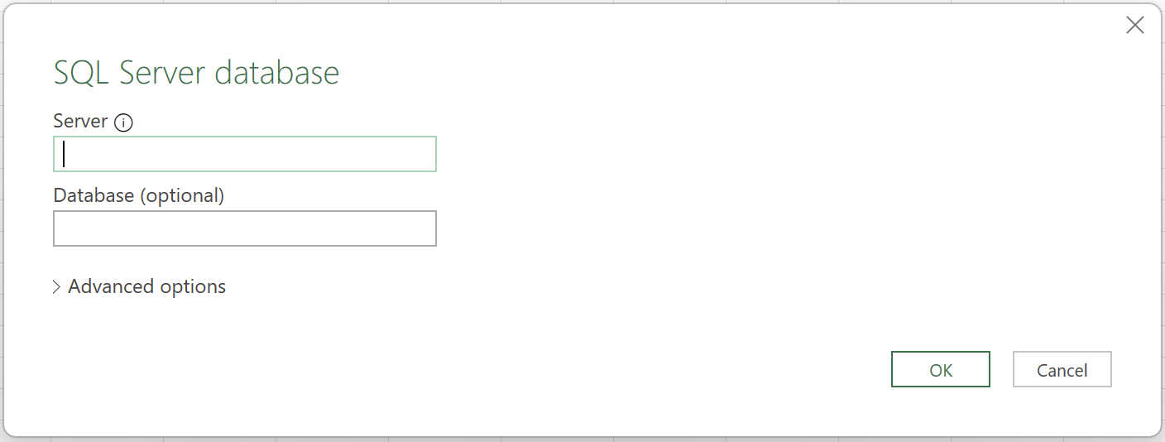
Data Transformation
5

Slide 20
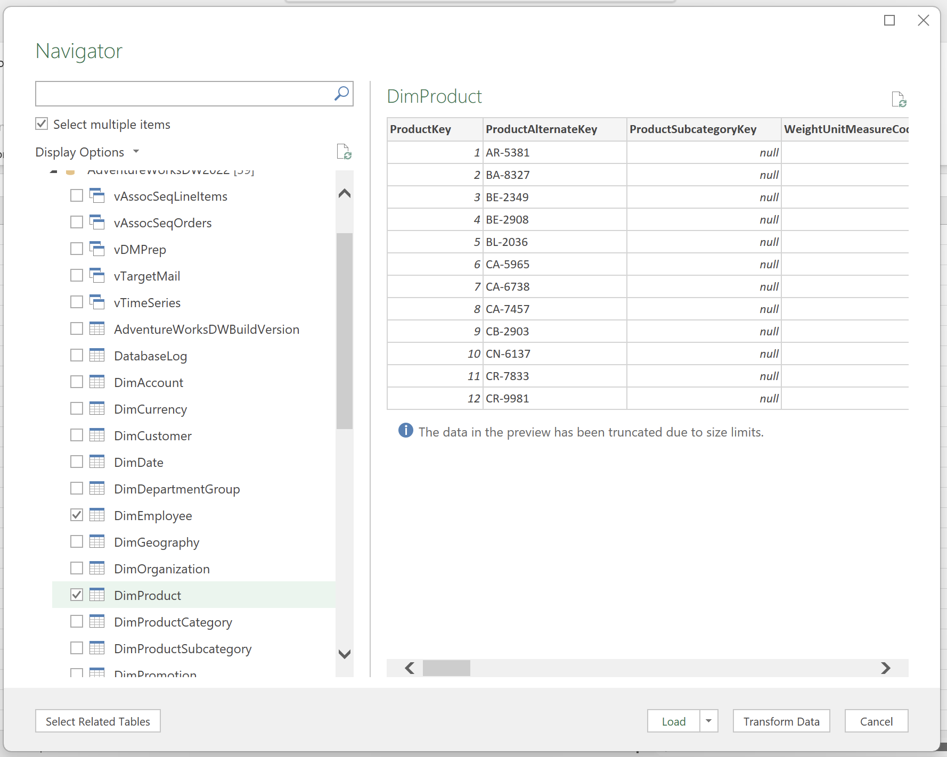
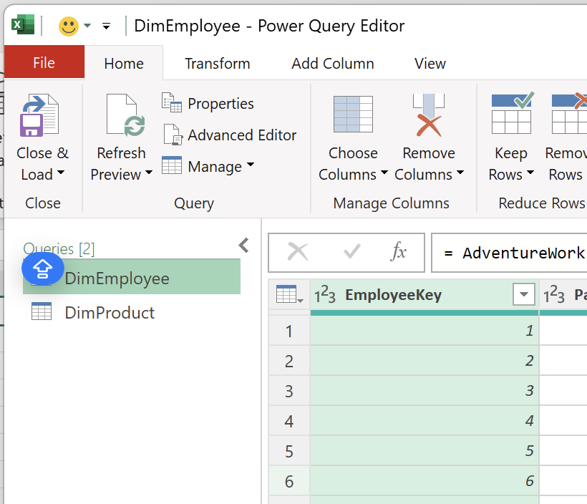
Data Transformation
POWER QUERY EDITOR
5

Slide 21

fullstackdatascience.com
References
https://cloud.google.com/bigquery/docs
https://datahubproject.io/docs/
11

Slide 22





Thank you
096 574 90 25
CREATED BY
Nguyen Tien Huy
info@robusto.ai
fullstackdatascience
huynt@fullstackdatascience.com
Data Manager
https://fullstackdatascience.com/
Hanoi, Vietnam

